Slide 1
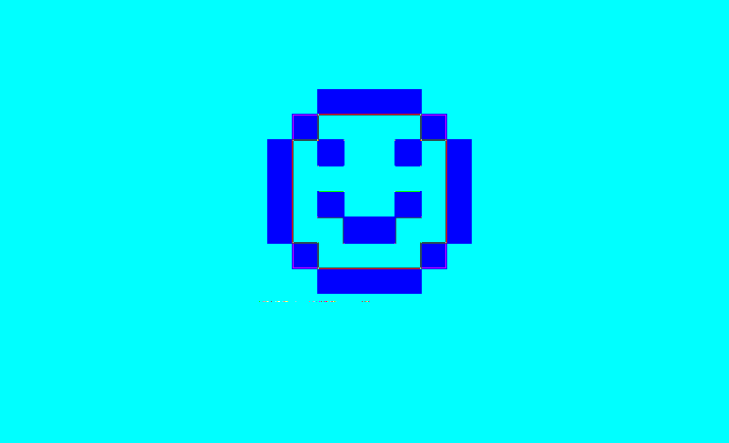
Cloud Jump
By Zak I., Cathryn F., Reagan D., Riena J.

Slide 2
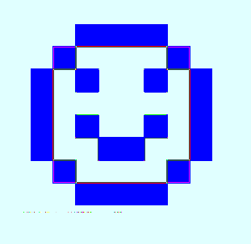
Game Mechanics
Goal was to create a jumping game similar to Doodle Jump
Players input the displayed number within a certain time limit to move onto the next level
Players receive ten points for every number they input correctly
Players lose if they do not input the number correctly and/or if they do not input the number in the given time
The game runs endlessly until the player loses

Slide 3
Roles
Zak
Make music play while the game runs
Create the character
Cathryn
Score board
Reagan
Introduction screen/loading screen
Created the clouds
Number functionality
Reina
Create the clouds
Instructions screen
Random Number Generator

Slide 4

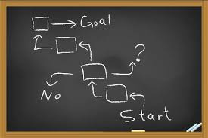
Original Goals vs New Goals
Original:
Create similar game to Doodle Jump with arrow keys and moving platforms
Add power-ups and ‘bad’ clouds
Multiple types of clouds and a changing background
New
Substitute arrow keys for animations after inputting correct numbers
Take away power-ups and ‘bad’ clouds
Add music
Game gets faster as it progresses

Slide 5
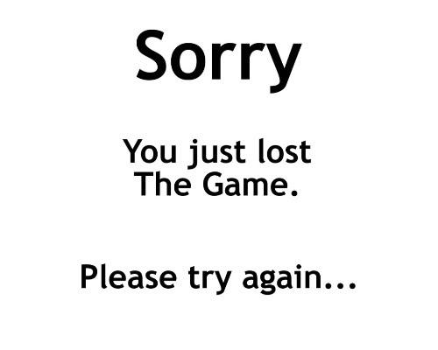
Challenges
Most everything was challenging to create, but eventually we either found out how to do them or found another way to do them.
Inputting the numbers
Creating the animations
Trying to create/display a BMP character and incorporating it into other group members’ code

Slide 6


Problems
Remembering how to create a random generator
Making the animations run smoothly
Getting the character back to a starting place after the animation
Keeping the score consistent

Slide 7
Solutions
Remembered/researched how to randomly generate numbers in a certain range
The score could be kept consistent by using increments and an integer type

Slide 8

Lessons Learned
That a for loop using i++ can be used with larger increments
How to display a character and a background
How to make the character jump on the clouds using various functions
How to create a (graphics screen) BMP character
How to create a game using c++

